Slide 1
Mimic One Frame Build Instruction (Example)

Slide 2
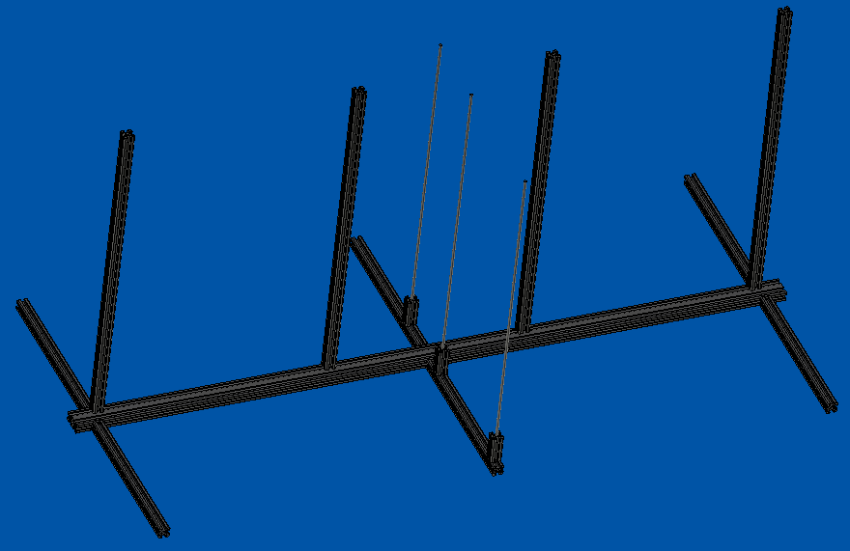
FWD
2020 Vertical Supports (4)
Extruded 2040 Base
Support Rods with Base (3)
2020 Frame Supports (6)

Slide 3
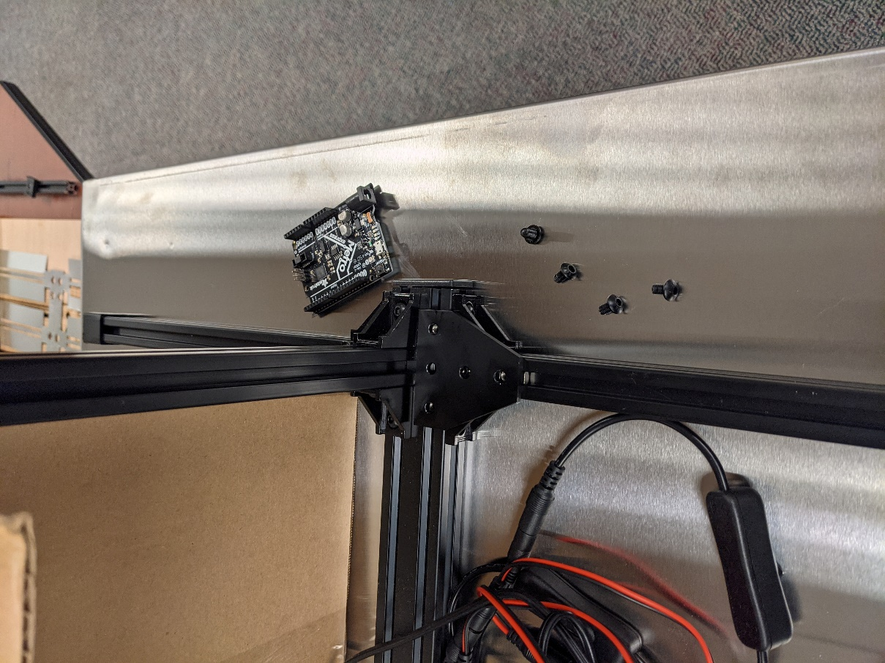
Step 1: Attach Frame Supports to 2040 Base (6 places)
2 small L-brackets each support, 2 Button Hex Screws each small L-bracket
Measurements are from centerline to centerline
2020 Frame Supports (6)
Frame Supports attached to 2040 Base by 2 small L-brackets using Button Hex Screws
Extruded 2040 Base
~610mm
~610mm
L-brackets

Slide 4
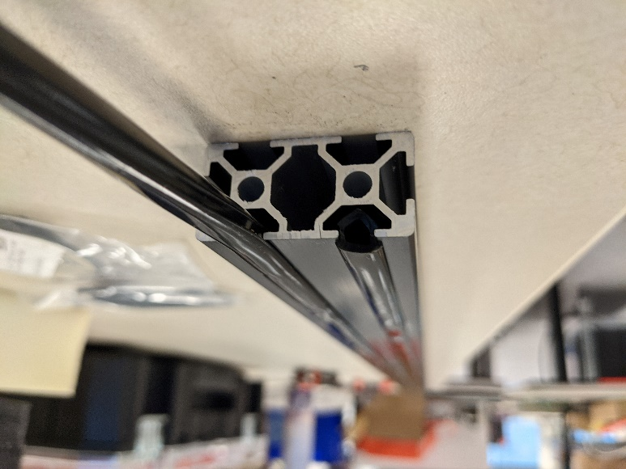
Step 1a: Cut Rubber Strips for Frame Supports (6 places) and 2040 Base (both grooves)
Install Rubber Strips in the underside grooves of Frame Supports and 2040 Base.
The Rubber Strip provides friction with the table and to fill the space between the table and the Rubber Feet on the end of the Frame Supports.
2020 Frame Supports (6)
Extruded 2040 Base (both grooves)
Underside Groove
2040 Base shown upside down
Rubber Strip

Slide 5
Step 2: Install T-Plates on end Frame Supports in the rear groove of the 2040 (2 places)
1 T-plate per end Frame Support, 5 Button Hex Screws and T-nuts on each T-plate
2020 Frame Supports (6)
Frame Supports attached to 2040 Base by 2 small L-brackets and 1 T-plate using Button Hex Screws
Extruded 2040 Base
T-plate
L-brackets

Slide 6
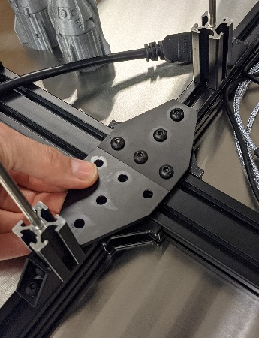
Step 3: Install T-Plates on center Frame Supports – one in forward groove, one in rear groove (2 places)
1 T-plate per center Frame Support, 5 Button Hex Screws and T-nuts on each T-plate
FWD
2020 Frame Supports (6)
Extruded 2040 Base
T-plates
Forward Groove in 2040
Rear Groove in 2040

Slide 7
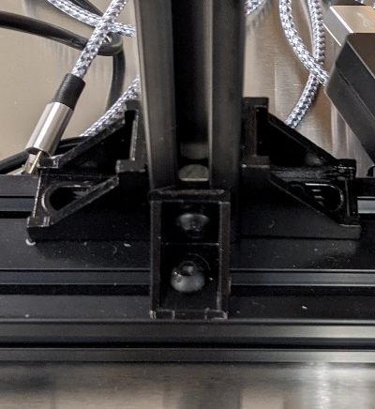
Vertical Supports (without T-plates) attached to forward groove with 2 small
L-brackets using
Button Hex screws
L-brackets
L-brackets
Vertical Supports attached to forward groove on 2040 Base by 2 small L-brackets using Button Hex Screws
FWD
2020 Vertical Supports (4)
446mm
347mm
433mm
Extruded 2040 Base
Measurements are centerline to centerline.
Need to update: outside dimensions should be the same.
Step 4: Attach Vertical Supports to forward groove in 2040 Base (4 places)
2 small L-brackets each support, 2 Button Hex Screws each small L-bracket

Slide 8
Vertical Supports (without T-plates) attached to forward groove with 2 small
L-brackets and 1
L-bracket anchored in rear groove
FWD
2020 Vertical Supports (4)
Extruded 2040 Base
Step 5: Add 1 large L-bracket anchored in rear groove in 2040 Base on center supports(2 places)
1 large L-bracket each support, 2 Button Hex Screws each small L-bracket

Slide 9
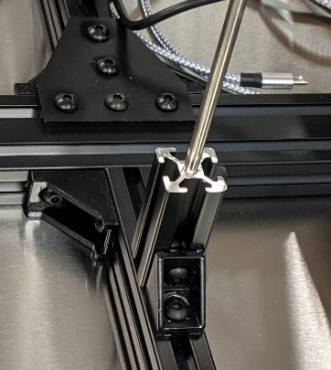
Step 6: Support Rod Bases on center Frame Supports (3 places)
1 large L-bracket per Support Rod Base, 2 Button Hex Screws each L-bracket
2020 Frame Supports (6)
160mm
243mm
Extruded 2040 Base
Vertical 2020 is flush
with end of the horizontal 2020
Support Rod Base attached to 2020 Frame Support by 1 large
L-bracket using Button Hex Screws
Support Rods with Base (3)
L-brackets

Slide 10
Step 7: Install Rubber Feet on Support Rod Bases (3 places)
Rubber Feet finish off ends of extruded Support Rod Bases and provide additional support with rods
Note, a cut will need to be made or a small hole drilled to allow Support Rod to pass through – hole must be smaller than rod to provide friction for extra stability
2020 Frame Supports (6)
Extruded 2040 Base
Add new photo with rubber
Rubber Feet on Support Rod Base
Support Rods with Base (3)

Slide 11
Step 8: Insert Support Rods in Support Rod Bases (3 places)
Support Rod will drop down into groove of Frame Support
2020 Frame Supports (6)
Extruded 2040 Base
Add new photo with rubber
Support Rod inserted through Rubber Feet into Support Rod Base
Support Rods with Base (3)

Slide 12
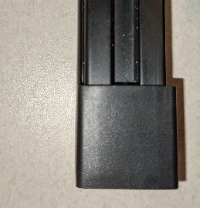
Step 9: Install Rubber Feet on Frame Supports (6 places)
Rubber Feet finish off ends of Frame Supports and provide friction with table
2020 Frame Supports (6)
Extruded 2040 Base
Support Rods with Base (3)

Slide 13

Step 10: Install End Caps on 2040 Base ends (2 places)
End Caps finish off ends of 2040 Base
Extruded 2040 Base
End Cap (2) inserted into end of 2040 Base

